Slide 1
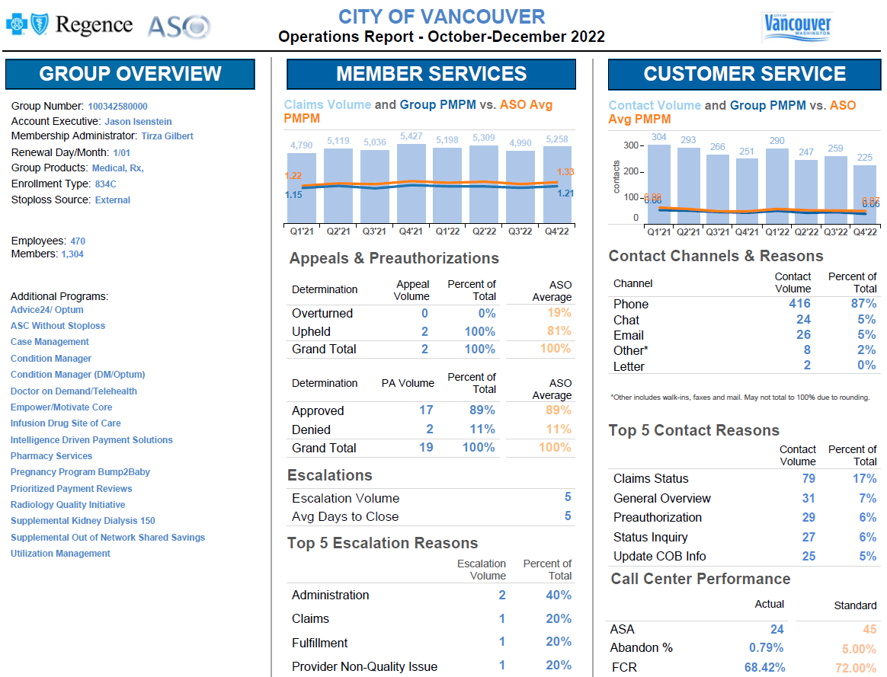

Slide 2
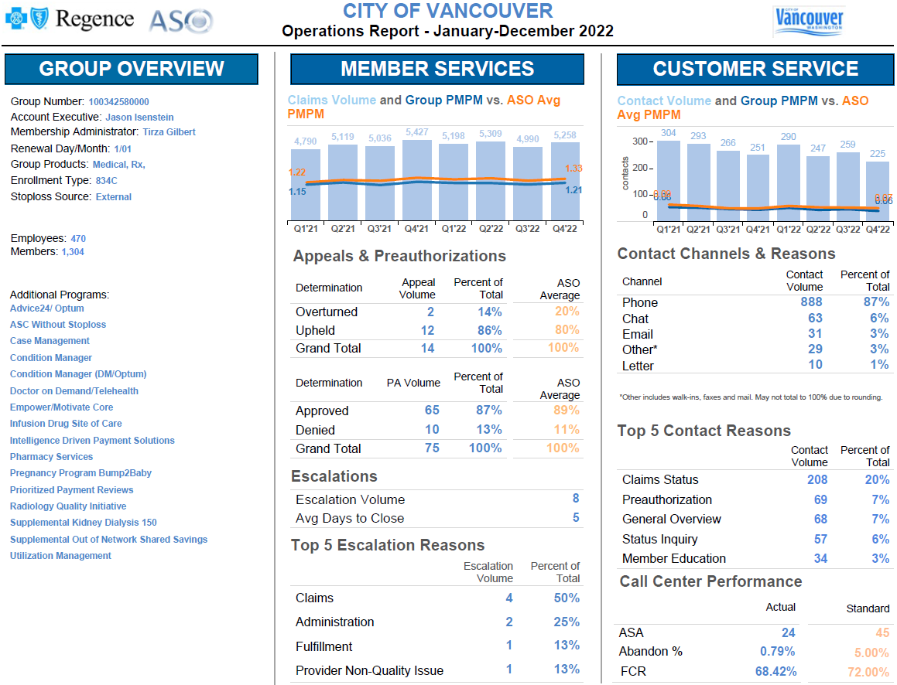

Slide 3
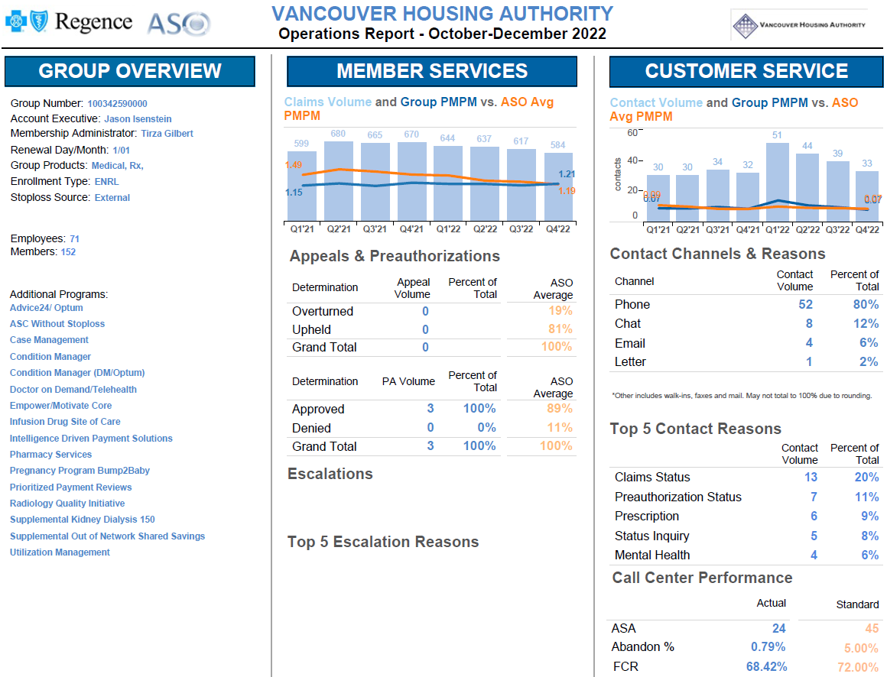

Slide 4
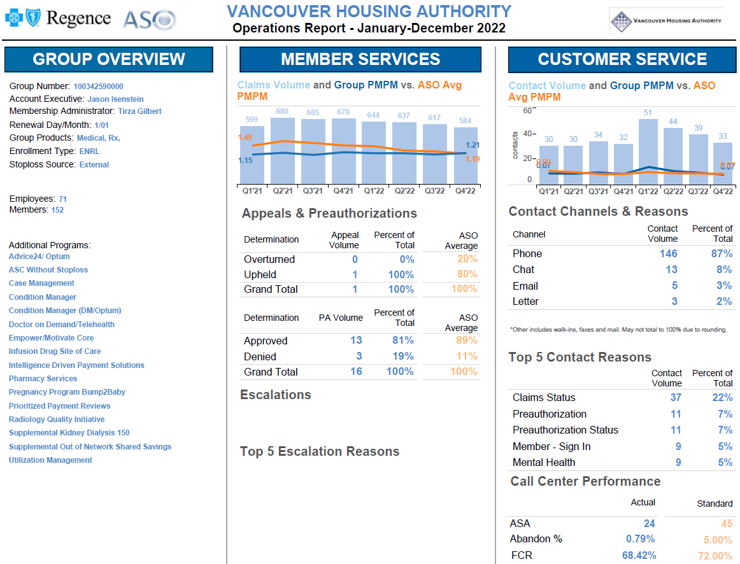

Slide 5
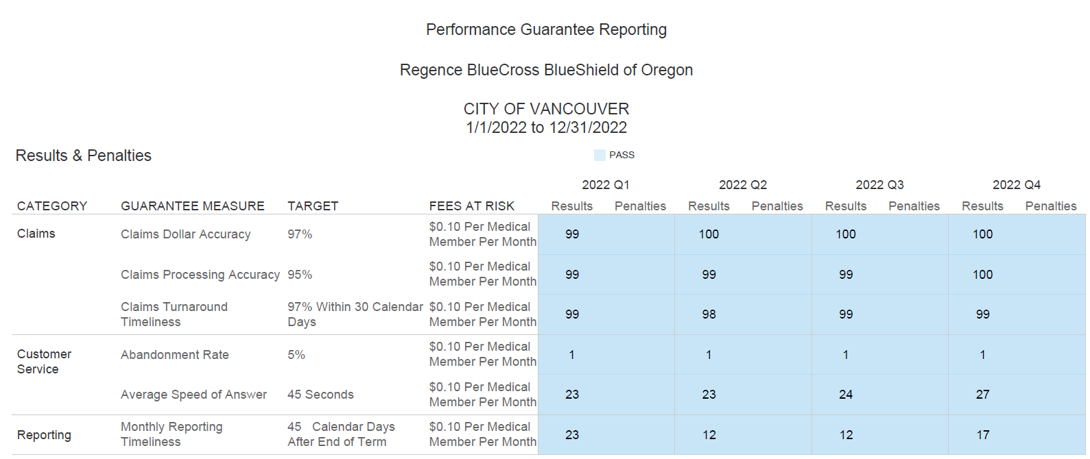
City of Vancouver Performance Guarantee Results 2022
Notes:
Claims Dollar Accuracy: tracks the percentage of audited claim dollars paid correctly. Examples of dollar/payment errors include, but are not limited to:
Claims paid in wrong amount (paid higher than non-authorized benefit level or paid at lower than the authorized level), Duplicate payment made, Payment of non-eligible benefits, Payment to ineligible enrollee (subscribers, dependents, member ID) or provider, Misapplied deductibles and maximums resulting in payment error, or Any charge missing from any portion of the claim.
Statistical errors, zero-paid, adjustments and denial codes due to computer logic and provider billing errors are excluded from this measurement. The net dollar amount of all errors on a claim should be counted when determining the total dollars processed accurately for that claim.
Claims Processing Accuracy: tracks the percentage of audited claims processed correctly. All financial errors are processing errors. Only one processing error per claim is counted even if more than one item on a claim caused an error. Examples of errors are defined as but no limited to:
Claims which are rejected incorrectly, Zero paid claims (e.g. all dollars applied incorrectly to deductibles resulting in no payment), Correct payment amounts but mailed/credited to wrong payee (e.g., correct amount mailed to provider instead of enrollee or to wrong provider), Misapplied deductibles or maximum that do not result in payment errors, and Claim overpayments or underpayments.
Statistical errors, denial codes due to computer logic and provider billing errors are excluded from this measurement.
Claims Turnaround Timeliness: tracks the percent of claims processed to the “approved to pay” status within the specified number of days. The processing period will be measured from the date the claim is received by the Plan or clearinghouse to the date the claim is processed and in the “approved to pay” status.
CS Abandonment Rate: tracks the percentage of abandoned calls calculated by dividing the number of abandoned calls (calls reaching the member service line and placed in queue but not answered because the caller hangs up) divided by the total number of calls.
Monthly Reporting Timeliness: tracks the number of days after the close of the reporting period it takes Regence to deliver the monthly on-demand reporting. If using Employer Center for online reporting, reports need to be available on the website within this timeframe
CS Avg Speed to Answer: tracks the average number of seconds between the time calls into the customer service call center are queued until the call is answered

