Slide 1
City of Vancouver 2024 Charter Review Committee Meeting #3; December 14, 2023
Notes:
Ben

Slide 2
Amendments: Mayor Pro Tem
Topic:
Article II: The Council
Notes:
Mayor Pro Tem

Slide 3
Q&A and Discussion: Charter Committee Reflections
Are there any clarifying questions?
Does the proposed recommendation align with the problem? Do we collectively understand the “why”?
Notes:
Ben

Slide 4
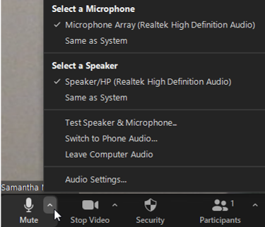
Zoom Meeting Tips for Committee Members
Please see below webinar instructions and tips below:
If you have not already connected your audio, click on the arrow next to the microphone icon, then click “Join Computer Audio” or “Switch to Phone Audio” to connect your computer speakers or to view the conference line information.
Please keep yourself on mute when not speaking. To mute and unmute, either select microphone icon, or use your personal phone.
Use video if possible, to promote face to face communication. Click the video icon to turn on your webinar camera.
If you are experiencing technical difficulties, please send a text to Maria Verano at (541) 514-1995.
4
Notes:
Ben

Slide 5
Zoom Meeting Tips
5
Notes:
Ben

Slide 6
Meet the City of Vancouver Team
Aaron Lande
Policy and Program Manager
Nena Cook
Deputy City Attorney
Kerry Peck
City Manager’s Office Administrative Assistant
Notes:
Aaron
Nena
Kerry

Slide 7
Charter Review Timeline
Orientation, Committee Charge, Adoption of Ground Rules, Review of Process, Opening Remarks by the Mayor
Notify auditors office of ballot measures
Update to council on Charter Committee progress
Council members are invited to present issues
Voter pamphlet materials due to auditors' office
Community members are invited to present issues
Adoption of recommendations for council
General election
Community members are invited to present issues & committee deliberations
Reserved as needed
Council deliberation and approval
Committee Deliberations
Oct
Nov
Dec
Jan
Feb
Mar
Apr
May
Jun
Jul
Aug
Nov
Notes:
Ben/Aaron

Slide 8
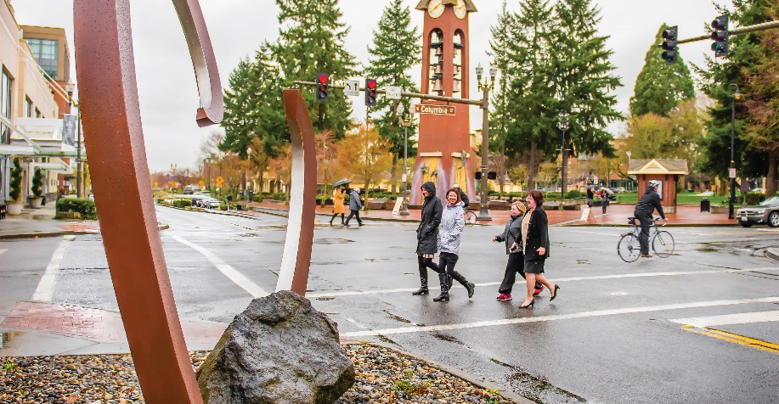
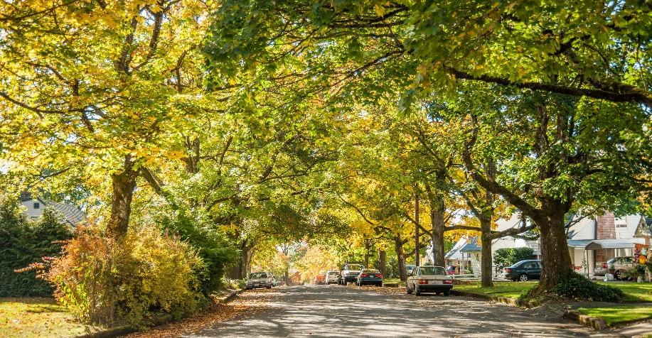
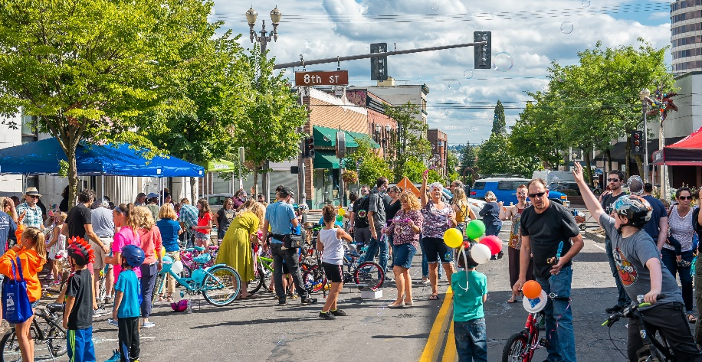
Meeting #3 Objectives
Recap and reflection on Charter Review Committee Meeting #2
Introduction of City Proposed Amendments
Introduction of Community Proposed Amendments
Discussion and deliberation of amendments
Identification of any edits, concerns, and agreement
Notes:
Ben

Slide 9
Agenda
Welcome, Agenda, and Introductions
Discussion: Introduction of City Proposed Amendments
Discussion: Introduction of Community Proposed Edits
Public Comment/Community Connections
Next Steps and Conclusion
Adjourn
Notes:
Ben

Slide 10
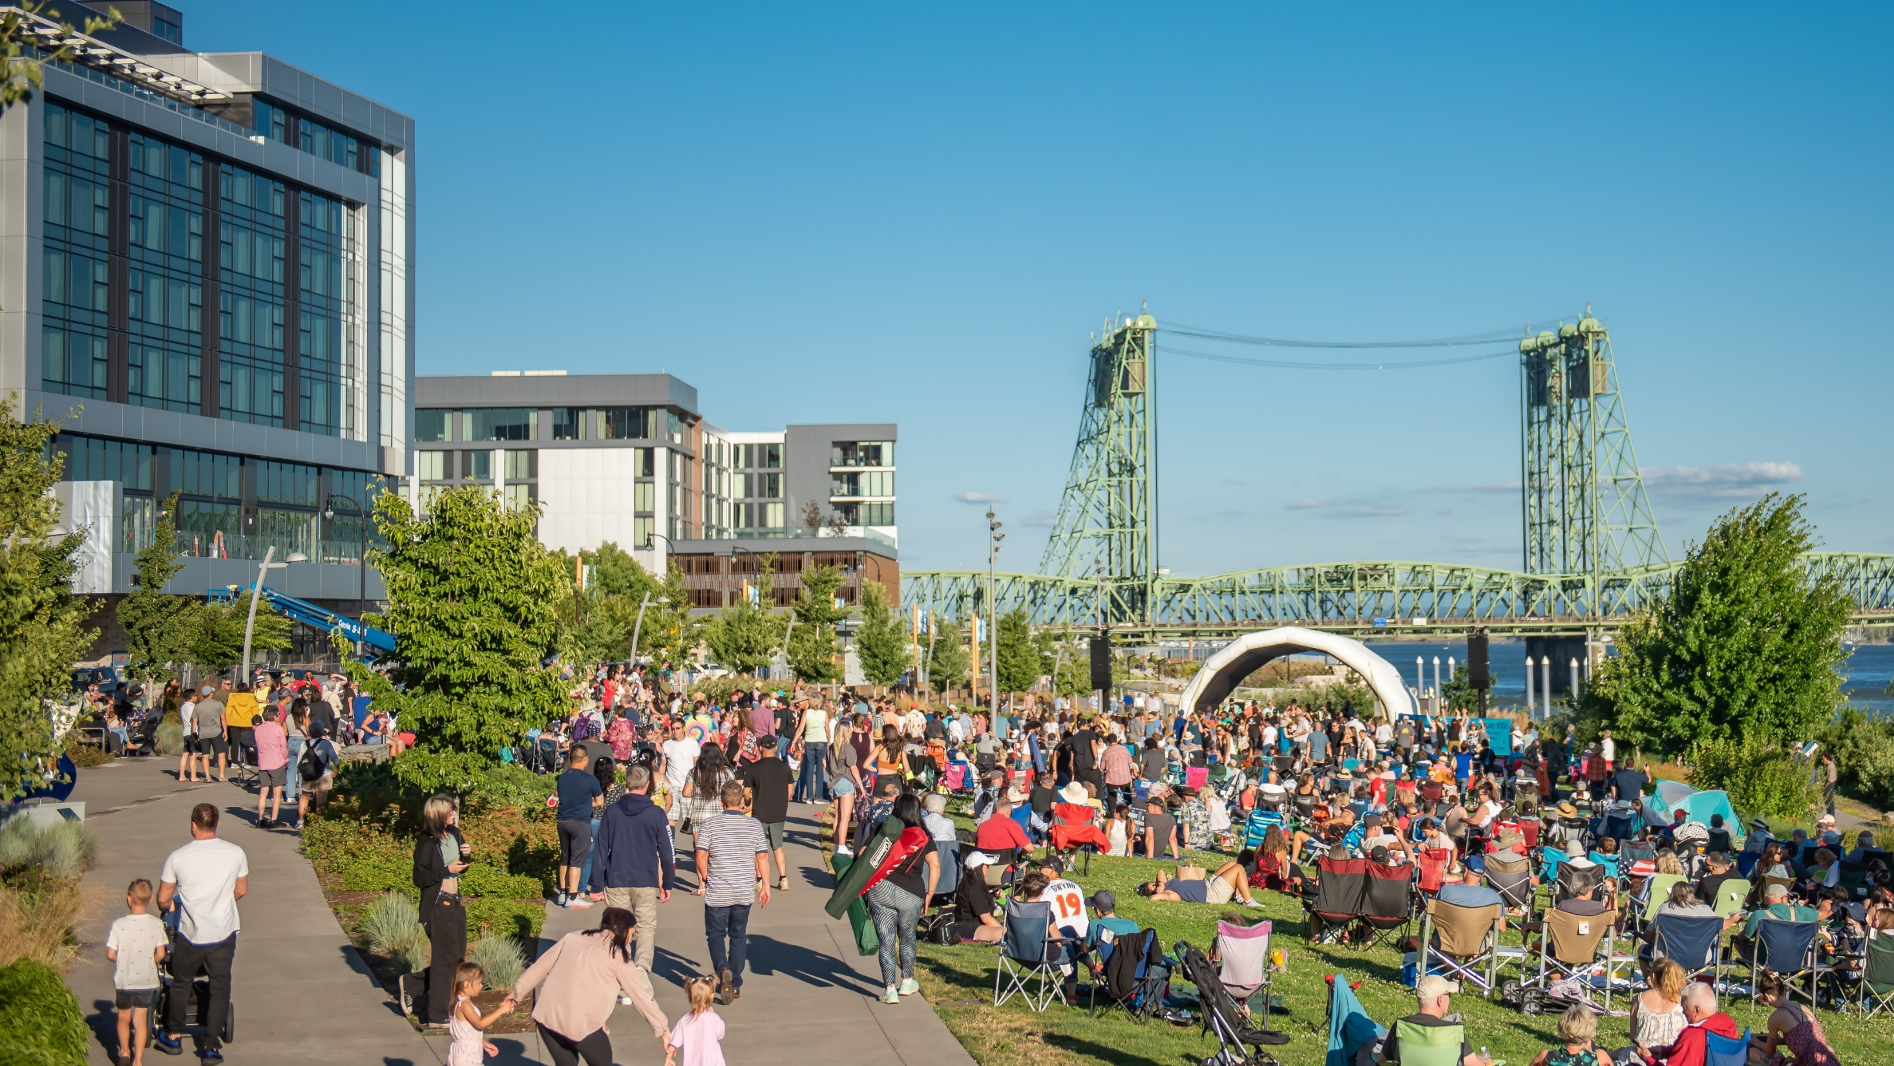
Fully participate in Work Group meetings
Come prepared for meetings
Participate in an open and mutually respectful way
Balance of speaking time
Serve as a liaison to your larger community of interest
Act in good faith
Notes:
Ben

Slide 11
Recap Meeting #2
Recap and reflection on Charter Review Committee Meeting #2
Introduction of Proposed Amendments ​
Discussion and deliberation of amendments ​
Identification of any edits, concerns, and agreement
Notes:
Ben

Slide 12
Introducing City Proposed Amendments
Notes:
Ben

Slide 13
Amendments: Law (1 of 2)
Section 11.05 Contracts Beyond One Year: No contract involving the payment of money shall be made for a period of more than five years unless approved by ordinance.
(Amended by the vote of the people on November 5, 2019.)
Proposed Amendment: Delete Section 11.05 from the City Charter in its entirety.
Notes:
Law

Slide 14
Q&A and Discussion: Charter Committee Reflections
Are there any clarifying questions?
Does the proposed recommendation align with the problem? Do we collectively understand the “why”?
Notes:
Ben

Slide 15
Amendments: Law (2 of 2)
Section 2.18d Citizens’ Commission on Mayor/City Council Salaries: The commission may adopt a schedule of [annual] salary increases [the same way the City adjusts fees and charges to reflect an increase up to the change in the Consumer Price Index equal to an average of the prior two complete calendar years (Two-Year Average Adjustment).] at the Consumer Price Index for Wage Earners and Clerical Workers (CPI-W) for the West region as established by the Bureau of Labor Statistics for the prior two years. If the Bureau of Labor Statistics discontinues publishing such index, the most similar index as determined by the city chief financial officer shall be applied. The commission may propose a schedule of salary increases of more than CPI-W the [Two-Year Average Adjustment] provided that such schedule shall be submitted to the voters for approval. In the event the voters reject such greater increase, the increase within the foregoing limits shall go into effect. The commission may decrease salaries, provided that such decreases shall not be effective until the commencement of a new term of office. The commission may also choose not to adopt any salary change. The commission shall file its schedule of salary adjustments, if any, for the positions of Mayor, Mayor Pro Tempore, and Councilmember with the City Clerk by May [July] 1 of the applicable year, so as to coincide with the City budget cycle.
Notes:
Law

Slide 16
Q&A and Discussion: Charter Committee Reflections
Are there any clarifying questions?
Does the proposed recommendation align with the problem? Do we collectively understand the “why”?
Notes:
Ben

Slide 17
Introducing Community Proposed Amendments
Notes:
Ben

Slide 18
Q&A and Discussion: Charter Committee Reflections
Are there any clarifying questions?
Does the proposed recommendation align with the problem? Do we collectively understand the “why”?
Notes:
Ben

Slide 19
Public Comment Instructions
To verbally ask a question or make a comment:
If you have joined by Zoom, click “Raise Hand.”
If you have joined by phone, press *9 to raise your hand.
If you have joined in-person, raise your hand.
The facilitator will call on participants. If you are joining virtually, you will receive an “unmute” request. Please accept it. If you are commenting by phone dial *6 to unmute.
Please provide your name and any affiliation.
Attendees will be allocated up to three minutes for public comment depending on the number of commenters.
If we run out of time and you have not had a chance to speak, you can still provide written comments after the meeting.
*9
Notes:
Ben

Slide 20
Next Steps
Project team to send Meeting #3 reflections form to committee members
Committee members to complete Meeting #3 reflections form
Committee members to share public input opportunities with community members
Meeting #4: January 23, 5-7pm
Committee members to share availability for 2024 Charter Committee meetings
Notes:
Ben

Slide 21
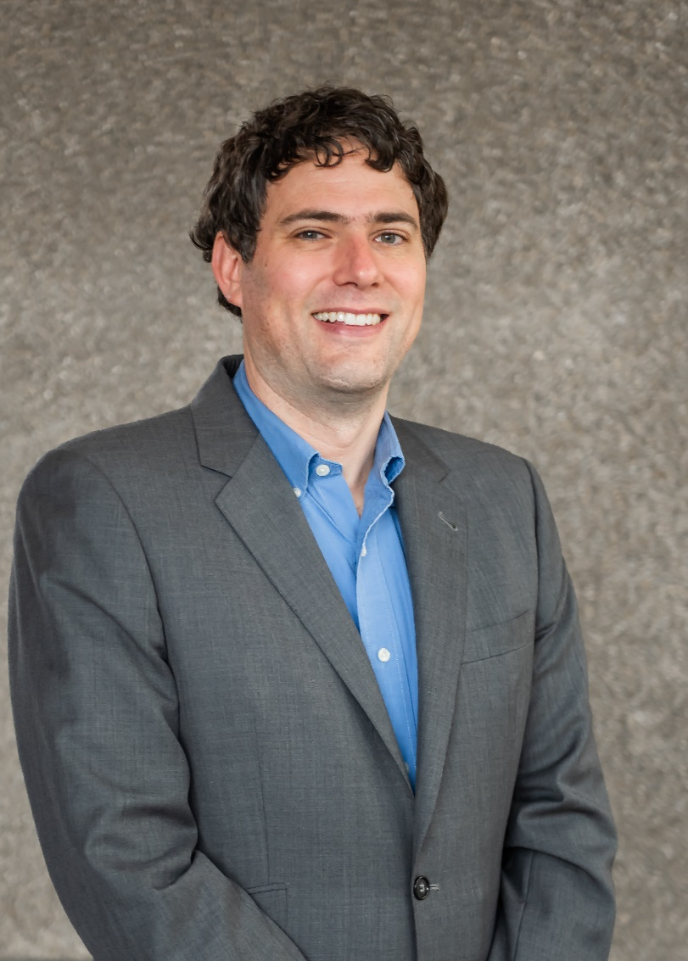
Contact Us
Aaron Lande
City of Vancouver Policy & Program Manager
Aaron.Lande@CityofVancouver.us
Notes:
Aaron

Slide 22
Adjourn

